Slide 1
Automatic Skin Disease Diagnosis Website
This presentationoutlines aninnovative project focusedondevelopingan automatic skin
disease diagnosis system utilizes deep learning, this tool aims to provide fast accurate
and accessible diagnostic assistance for various skin conditions, ultimately improving
patients out comes
This presentation introduces an innovative and intelligent web-based platform designed to assist in the early detection of skin diseases using image processing and machine learning. We will explore how the integration of multimedia elements and AI technologies enhances user interaction, improves diagnostic accuracy, and supports healthcare accessibility.
Presented by
Vaiga D. S
Abhirami C. S
Vismaya V. M
Abhijith A. C
Muhammed Arfan. N
Notes:
Presented by
Vaiga D. S
Abhirami C. S
Vismaya V. M
Abhijith A. C
Muhammed Arfan. N

Slide 2
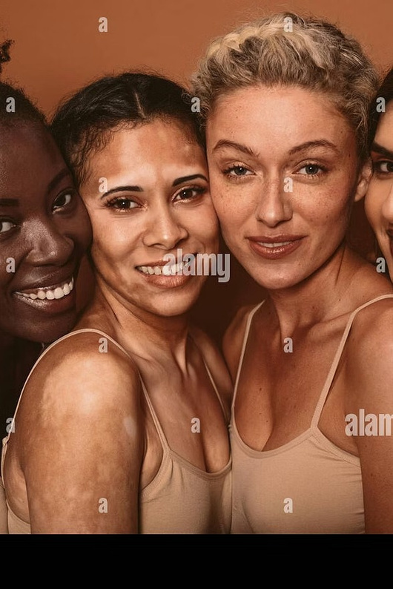
The Challenge of Skin Diseases
Skin diseases impact asubstantialportionoftheglobalpopulation, rangingfromminor
irritations to severe, life-threatening conditions.The effectiveness of treatmentheavily relies on early detectionand precise diagnosis.
Current diagnostic methods can be time-consuming and may require specialized
expertise, limiting accessibility in some regions. This project addresses these challenges
by offering a rapid and reliable diagnostic alternative.

Slide 3
Introducing the Automatic Diagnosis System
This project presentsan automaticskin diseasediagnosissystembuilt upon advanced deeplearningtechniques. Our primary goal is to assist
dermatologists andhealthcareprofessionalswitha fast,cost-effective, and accessible diagnostictool.
The system is designed to streamline the diagnostic process, enabling earlier intervention and potentially leading to better patient outcomes.
Fast Diagnosis
Cost-Effective
Accessible
Quick results for timely intervention.
Reduces the need for expensive, specialized consultations.
Available to a wider population, especially in underserved areas.

Slide 4
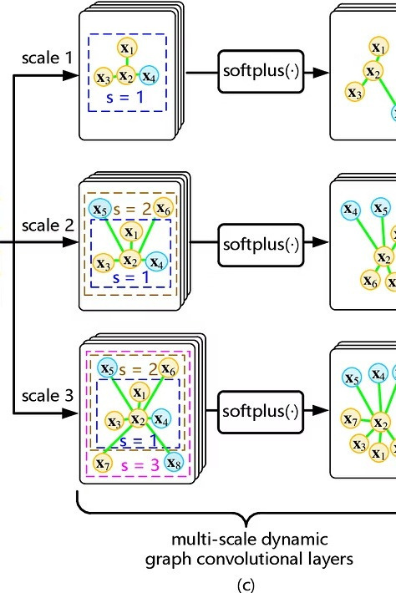
Leveraging Deep Learning: CNNs
At the core of our system are Convolutional Neural Networks (CNNs), a powerful deep learning technique particularly effective for image recognition tasks. CNNs are trained to identify intricate patterns and features within dermatoscopic images. This allows the model to learn and differentiate between various skin conditions with high precision, mimicking the diagnostic capabilities of human experts.

Slide 5
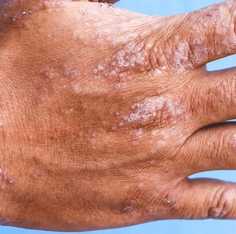
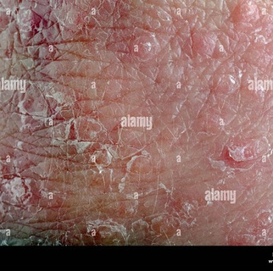
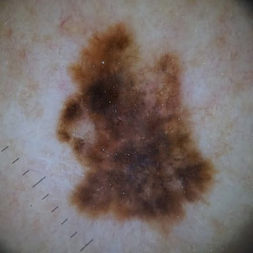
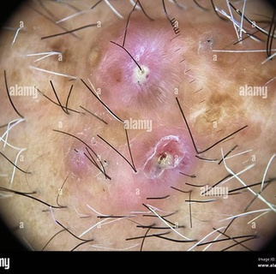
Training with Labeled Datasets
The accuracy of ourdeeplearning model is achievedby trainingiton a comprehensive labeled dataset of dermatoscopic images. Each image in the dataset
ismeticulously categorizedwithits corresponding skin condition.
This rigorous training process enables the CNN to accurately classify a wide range of skin conditions, ensuring robust and reliable diagnostic results.

Slide 6
Diagnosing Common Skin Conditions
Our system is capable of classifying various prevalent skin conditions with high accuracy. This includes:
Acne And Rosacea
Actinic Keratosis Basal Cell Carcinoma And Other Malignant Lesions
Atopic Dermatitis
Ba Cellulitis’
Ba Impetigo
Benign
Bullous Disease
Cellulitis Impetigo And Other Bacterial Infections
Eczema
Exanthems And Drug Eruptions
Fu Athlete Foot
Fu Nail Fungus
Fu Ringworm
Hair Loss Photos Alopecia And Other Hair Diseases’
Herpes Hpv And Other Stds
Light Diseases And Disorders Of Pigmentation
Lupus And Other Connective Tissue Diseases
Malignant
Melanoma Skin Cancer Nevi And Moles
Rashes

Slide 7
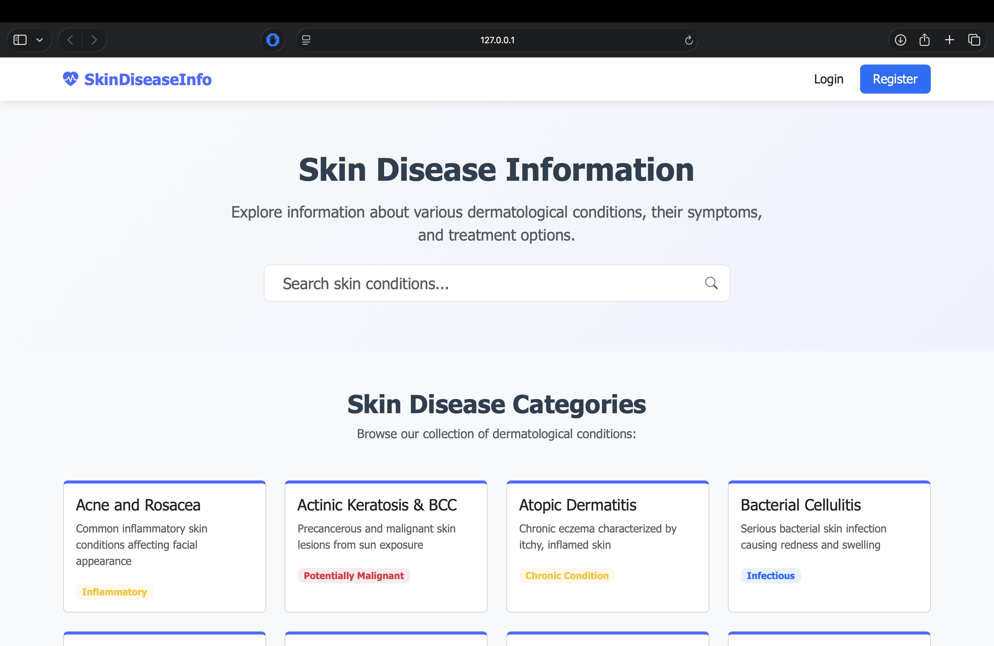
User-Friendly Interface and Deployment
The system is deployed via an intuitive and user-friendly interface, ensuring ease of use
for healthcare professionals and patients alike. The design prioritizes simplicity and efficiency.
Users can easily upload an image of the affected skin area and receive instant diagnostic
results, making the process seamless and accessible.

Slide 8
Impact on Healthcare and Patient Outcomes
This automatic diagnosis system has the potential significantly impact healthcare by:
Improving earlyintervention for skin diseases.
Reducing diagnostic delays.
Providing a valuable tool for remote consultations.
Enhancing overall patient outcomes through timely and accurate diagnoses.
It serves as a supportive tool, not a replacement, for expert medical opinion.
Timely Diagnosis
Enhanced Access
Better Outcomes
Reduces waiting times for results.
Extends diagnostic capabilities to more areas.
Facilitates quicker treatment decisions.

Slide 9
Key Takeaways & Future Outlook
Automatic skin disease diagnosis is revolutionising dermatology, offering a future of proactive and accessible skin health management.
Enhanced Accessibility
Provides vital diagnostic support in remote areas, bridging healthcare
gaps.
Early Identification
AI enables prompt detection of serious diseases like skin cancer,
improving treatment outcomes.

Slide 10

Benefits of Automatic Skin Disease Diagnosis
These solutions offer significant advantages in healthcare delivery and patient outcomes
🌍 Fast Diagnosis
Results are available in seconds or minutes, accelerating the diagnostic process.
🌍Accessible
Provides crucial help to people in rural or remote areas with limited access to dermatologists. Data-Driven Systems improve over time with more data and feedback,
enhancing accuracy
🌍Cost Effective
Reduces the need for multiple hospital visits, lowering healthcare expenses
🌍Data-Driven
Systems improve over time with more data and feedback, enhancing accuracy and reliability.

Slide 11
Hardware Requirement
CPU: Intel i7 / AMD Ryzen 7 or higher
RAM: 16–32 GB
GPU: NVIDIA GTX 1660 / RTX 2060 or higher (with at least 6 GB VRAM)
Storage: 512 GB – 1 TB SSD
Software Requirement
Operating System: Windows, macOS, or Linux
Programming Language: Python 3.9+
Web Framework: Flask
ML Libraries:
NumPy, Pandas (data handling)
Scikit-learn, TensorFlow
Frontend / Templates: HTML, CSS, JavaScript, Jinja2
Development Tools: VS Code Jupyter Notebook
Database (optional): SQLite
Optional (for GPU ML models): CUDA + cuDNN

Slide 12
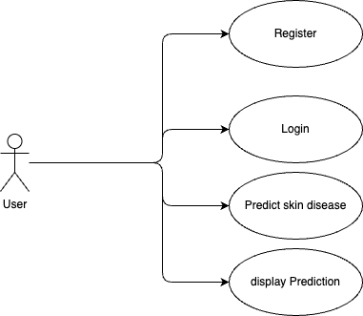
Use Case Diagram

Slide 13
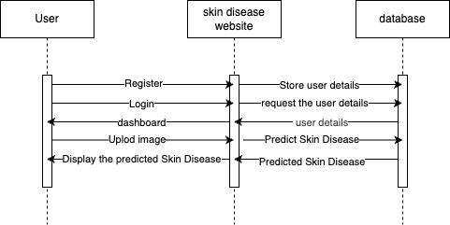
Sequence Diagram

Slide 14
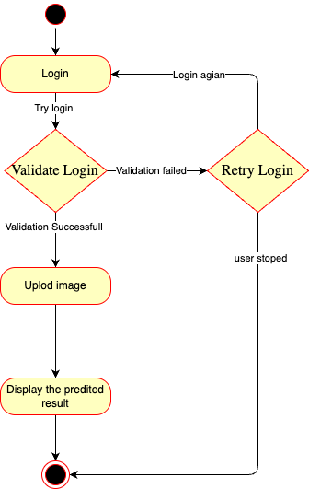
Activity Diagram

Slide 15
Conclusion
The Automatic Skin Disease Diagnosis Website is a smart and accessible tool that leverages machine learning and image processing to assist in early detection of skin diseases. By allowing users to upload images and receive instant analysis, the system reduces the need for immediate clinical visits, making basic healthcare more accessible especially in remote areas . This project not only demonstrates the potential of AI in medical diagnostics but also highlights how technology can be used to promote health awareness and preventive care . With further development, it can be integrated into telemedicine systems and contribute to faster, more reliable dermatological support.
.

Slide 16



